Slide 1
Introduction to Probabilistic Programming Languages (PPL)
Anton Andreev 14/02/2018
Ingénieur d'études CNRS

Slide 2

Something simple
int function add(int a, int b)
return a + b
add(3, 2)
5
Deterministic program is a very precise model - the same input always produces the same output
Notes:
This is a deterministic program.

Slide 3

Deterministic programs are not interesting because they always give the same result
Notes:
Although we spend hours (days) to debug make them deterministic.

Slide 4
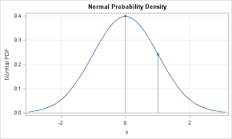
Some statistics
probabilistic (stochastic) model/program is the opposite of deterministic program
stochastic process/random process - represents the evolution of some system of random values over time (again opposite of deterministic process)
programs – if, else, for, while (usually line by line)
distribution – gives the probability that a random variable is exactly equal to some value
distributions have parameters
Notes:
In a stochastic or random process there is some indeterminacy: even if the initial condition (or starting point) is known, there are several (often infinitely many) directions in which the process may evolve.
Example: So stock market fluctuations can be modeled by as several stochastic processes.
Discrete distributions are usually modeled with PMF (probability mass function)
PDF is a function that describes the relative likelihood a continuous random variable to take on a given value. The normal distribution is modeled by a PDF. PDF usually a represented by a formula (that includes the parameters of the distribution).
Distribution - modeled as PDF/PMF – modeled by parameters

Slide 5
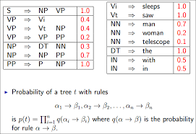
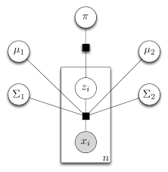
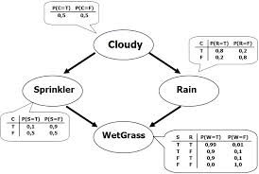
Motivation
Probabilistic Models:
incredibly powerful (Machine learning/AI)
the tools for creating are:
a complete mess
incredibly heterogeneous (Math, English, Diagrams, Pictures)
bigger models get really hard to write down
Notes:
Examples: probabilistic context free grammar, factor graphs (built from random variables and factors).
What we need is some universal way to define PM (Probabilistic Models)

Slide 6
What is PPL (1)
Probabilistic programming languages simplify the development of probabilistic models by allowing programmers to specify a stochastic process using syntax used in general purpose programs.
Probabilistic programs generate samples from the modeled joint distribution and inference is performed automatically given the specification (the model).
http://probabilistic-programming.org
Notes:
PPL allows you to encode a probabilistic model to represent a stochastic process using tools that we already know (programming languages that we already know).
So what you get at the end of your program is a joint distribution.

Slide 7
What is PPL? (2)
Computer science Statistics Probabilistic Programming
Input
Data (provided)
Parameters
Program
Generative Model
Program
(random variables)
Output
X
Observations
Notes:
Parameters describe these distributions. For example Gaussian is defined by (mean, std).
Probabilistic programming:
We use program to describe our distribution. And then generate samples.

Slide 8
What is PPL? (3)
We would like to construct a model in a way similar to a computer program
The model is built to generate the observations
A built-in inference engine takes the observations and returns the distributions (over the settings) of the parameters that could have generated the observations
The built-in inference engine is part of the “compiler”.
Parameters
Program
(random variables)
Observations

Slide 9
Built-in inference engine
Provided by compiler
Program
(probabalistic model)
Execution
+
Inference algorithms
Clear separation between model and inference algorithmes
Notes:
So PPL let us focus on the model and not on the inference. Why? Because implementing inference algorithms is not easy. We can do it ourselves, but why reinvent the wheel each time and not leave this to the compiler. Also in many cases our custom implementation will contain bugs. So it is better to leave this job to researches that specialize in probabilistic inference. The inference can be built in the compiler or it might come as an extra library that provides the “probabilistic primitives”.
Inference algorithms: variable elimination, dynamic programming, message passing, Monte Carlo.

Slide 10
Bayes net (or Bayesian network)
TB=t
0.1
flu=t
0.2
flu | Sneeze=t
t | 0.8
f | 0.2
TB | flu | Cough=t
t | t | 0.9
t | f | 0.8
f | t | 0.75
f | f | 0.1
TB
flu
cough
sneeze
Notes:
Bayes(ian) model or probabilistic directed acyclic graphical model is a probabilistic graphical model PGM (a type of statistical model) that represents a set of random variables and their conditional dependencies via a directed acyclic graph (DAG).
For example, a Bayesian network could represent the probabilistic relationships between diseases and symptoms. Bayes net are representation of a distribution.
CPT – conditional probabilistic table

Slide 11
Bayes net
Probabilistic graphical model (directed and acyclic)
Represents a set of random variables
Shows the conditional dependencies between the random variables
Representation of a distribution

Slide 12
Same Bayes net converted to PPL (Church)
(define samples
(mh-query 100 100
(define TB (flip 0.1)) ;not a fixed constant value
(define flu (flip 0.2))
(define cough (or (and TB (flip 0.33)) (and flu (flip 0.54))))
(define sneeze (and flu (flip 0.8)))
TB ;query (what is the probability of tuberculosis)
(and cough flu) ;conditions
)
)
(hist samples "chances of TB")
Notes:
Here we get this compact representation.

Slide 13
Objectives of PPL
To benefit from automatic inference over models
new inference methods have been developed
computers are powerful enough
Generative model as code
more intuitive
simplification - less math, lower technical barrier for development of new models
models can be shared and stored in public repositories (just like code)
faster development of cognitive models can boost AI research

Slide 14
List of PPLs (over 20)
Church – extends Scheme(Lisp) with probabilistic semantics
Figaro – integrated with Scala, runs on the JVM (Java Virtual Machine)
Probabilistic C#
Anglican – integrated with Clojure language, runs on JVM
Infer.net – integrated with C# , runs on .NET, developed by Microsoft Research, provides many examples
WebPPL – from the creators of Church, Java script based
Stan
BUGS
Pyro – Uber AI Labs (deep learning + bayesian modeling)
https://eng.uber.com/pyro
Notes:
Functional languages seem appropriate for Probabilistic programs.
problem in web search: inferring the relevance of documents from the sequence of clicks made by users on the results page

Slide 15
Classification of PPLs
PPL can be:
new language
Host language + library
Time to learn host language?
Slow IDE, slow compiler, slow execution
Good documentation? Support forum?
Easy to incorporate in commercial project?
License restricted?
Notes:
Figaro / Infer.net/ Probabilistic C# easier for commercial project implementation.
Infer.NET license restricted.
Church, Figaro, Infer.NET have good documentation with examples.
Probabilistic C# has a tutorial, but it is not well documented.

Slide 16
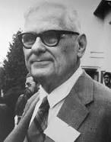
Church PPL
Named after Alonzo Church
Designed for expressive description of generative models
Based on functional programming (Scheme)
Can be executed in the browser
Every computable distribution can be represented by Church
Web-site: http://projects.csail.mit.edu/church/wiki/Church
Interactive tutorial book: https://v1.probmods.org
Notes:
So the code in the next section will look like scheme.
Alonzo Chuch – mathematical logic.

Slide 17
“Hello world” in Church (1)
Sampling example
;All comments are green, “flip” is primitive that give us a 50%/50% T/F
(define A (if (flip) 1 0))
(define B (if (flip) 1 0))
(define C (if (flip) 1 0))
(define D (+ A B C))
D ;we ask for a possible value when summing A, B and C just one time
Result: 2
“2” is just one sample - one of 4 possible answers (0,1,2,3)
We are simply running the evaluation process “forward” (i.e. simulating the process)
This is a probabilistic program
Notes:
Next run of the program might give us another answer.
Dice example.

Slide 18
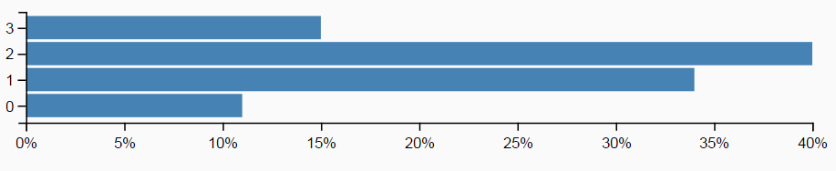
“Hello world” in Church
Sampling example (2)
(define (take-sample)
(define A (if (flip) 1 0))
(define B (if (flip) 1 0))
(define C (if (flip) 1 0))
(define D (+ A B C))
D
)
(hist (repeat 100 take-sample))
Notes:
The result is a distribution.
Dice example.

Slide 19
Two execution strategies
write a distribution ask a question
PPL program
(Church)
PPL program
(Church)
Samples
Observations
Forward chaining Backward inference
Notes:
Flip gives us a distribution of 50/50

Slide 20
Queries template
(query ;church primitive
generative-model ;some defines to build our model
what-we-want-to-ask ;select the random variable that we are interested in
what-we-know) ;give a list of conditions/observations

Slide 21
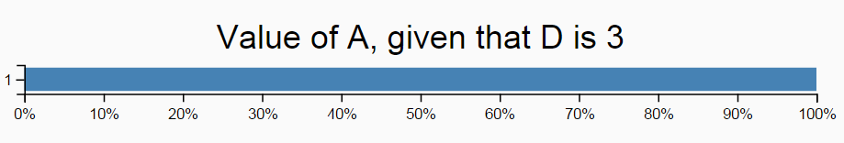
Example of “rejection-query”
(define (take-sample) ;name of our program/function
(rejection-query ;implemented for us using rejection sampling
(define A (if (flip) 1 0))
(define B (if (flip) 1 0))
(define C (if (flip) 1 0))
(define D (+ A B C))
A ;the random variable of interest
(condition (equal? D 3)))) ;constraints to our model
(hist (repeat 100 take-sample) "Value of A, given that D is 3")
Notes:
Example of rejection query
Rejection query is very slow.

Slide 22
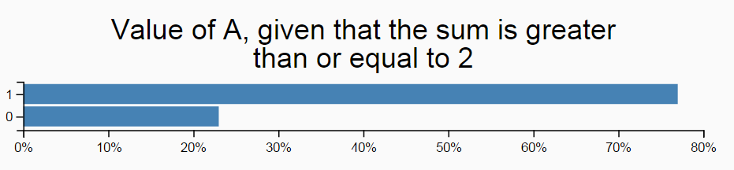
Example of “mh-query”
(define samples
(mh-query ;we ask/search/infer for something
100 100 ;number of samples ; lag
;we define our model
(define A (if (flip) 1 0))
(define B (if (flip) 1 0))
(define C (if (flip) 1 0))
A ;the random variable of interest
(condition (>= (+ A B C) 2)))) ;constraints to our model
(hist samples "Value of A, given that the sum is greater than or equal to 2")
Notes:
we could look at (>= (+ A B C) 2))) as another random variable, which is unnamed. We can more or less put everything as a condition and this shows the power of church although with variable efficiency. Mh-query is based on Metropolis Hastings (MH) algorithm.

Slide 23
Explaining away
P(TB) = 0.1
TB=t
0.1
flu=t
0.2
flu | Sneeze=t
t | 0.8
f | 0.2
P(TB|flu) = 0.1
TB | flu | Cough=t
t | t | 0.9
t | f | 0.8
f | t | 0.75
f | f | 0.1
P(TB|cough) = 0.293 ~ 30%
TB
flu
P(TB|cough,flu) = 0.128 ~ 13%
cough
sneeze
Notes:
TB and flu are the causes. Coughing and sneezing are the symptoms or observations. A model that goes from top to bottom – the top is the source or the cause and the bottom are the observations. So let’s reason about TB which is actually reasoning backwards.
TB and flu are independent. TB is conditionally dependent on coughing.
So first our degree of belief goes up and then by adding another observation it actually goes down. So probabilities are useful.
So we get non-monolithic reasoning, something non-linear happens. This does not happen if we simply use classical logic.

Slide 24
Cognitive example (1)
Learning about coins
A friend gives you a coin and you observe a certain amount of consecutive heads. Question is: is it a fair or trick coin?
Does 5 x H is normal?
Does 10 x H looks suspicious?
What about after 15 x H?
Our model:
Let’s consider only two hypotheses:
fair coin
trick coin that produces heads 95% of the time
The prior probability of seeing a trick coin is 1 in a 1000, versus 999 in 1000 for a fair coin.
Notes:
This “learning curve” reflects a highly systematic and rational process of conditional inference.
These probabilities determine the weight passed to make-coin. A weight of 0.5 indicates that the coin will give 50% heads, so it is a fair coin.

Slide 25
Cognitive example (2)
Learning about coins
H x 15
A priori information
Observations
Model
Question/query: Is it a fair coin?
Notes:
This is a discrete example.

Slide 26
Cognitive example (3)
Learning about coins
(define observed-data '(h h h h h)) ;configuring the observations
(define num-flips (length observed-data))
(define samples
(mh-query
1000 10
(define fair-prior 0.999) ;setting the a priori information
(define fair-coin? (flip fair-prior))
(define make-coin (lambda (weight) (lambda () (if (flip weight) 'h 't)))) ;we apply the a priori information
(define coin (make-coin (if fair-coin? 0.5 0.95)))
fair-coin? ;query
(equal? observed-data (repeat num-flips coin)))) ;we set the observed data as conditions for the query
(hist samples "Fair coin?")
Notes:
So we are searching which coin produced the observed result having in mind the the apriori information.

Slide 27
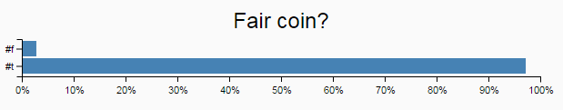
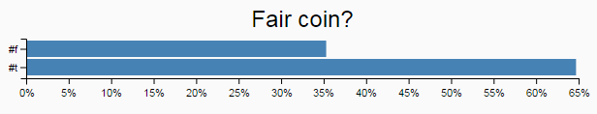
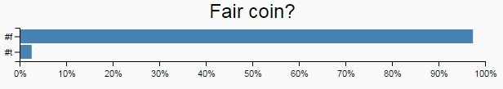
Cognitive example (4)
Learning about coins
1/1000 is fair
H x 5
1/1000 is fair
H x 10
50% is fair
H x 5
Notes:
If a priory we set 1/1000 is the chance to meet a biased coin and we have seen 5 heads.
If a priory we set 1/1000 is the chance to meet a biased coin and we have seen 10 heads.
If a priory we set 50% is the chance to meet a biased coin and we have seen 5 heads.

Slide 28
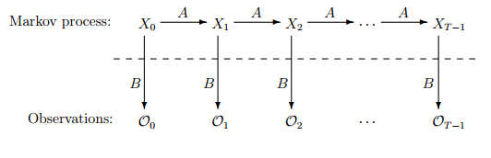
Example – Hidden Markov model (1)
Components of HMM:
A – state transition function
B – state to observation transition function
Initialization
Notes:
2 Transition functions

Slide 29
Example – Hidden Markov model (2)
(define states '(s1 s2 s3 s4 s5 s6 s7 s8 stop)) ;list of hidden states
(define vocabulary '(chef omelet soup eat work bake)) ;list of possible observations
(define state->observation-model ;generate observation transition probabilities (B)
(mem (lambda (state) (dirichlet (make-list (length vocabulary) 1)))))
(define (observation state) ;use B
(multinomial vocabulary (state->observation-model state)))
(define state->transition-model ; generate the state transition probabilities (A)
(mem (lambda (state) (dirichlet (make-list (length states) 1)))))
(define (transition state) ;use A
(multinomial states (state->transition-model state)))
(define (sample-words last-state) ;returns the next observation using the state and observation models
(if (equal? last-state 'stop)
'() (pair (observation last-state) (sample-words (transition last-state)))))
(sample-words 'start) ;generate a list of observations
Possible output: (work omelet omelet work work soup) ;possible observation sequence
Notes:
The idea here is show how intuitive the implementation of Hidden Markov Model is.

Slide 30
More examples in Church
https://v1.probmods.org
Probabilistic Context-free Grammars (PCFG)
Goal inference
Communication and Language
Planning
Learning a shared prototype
One-shot learning of visual categories
Mixture models
Categorical Perception of Speech Sounds

Slide 31
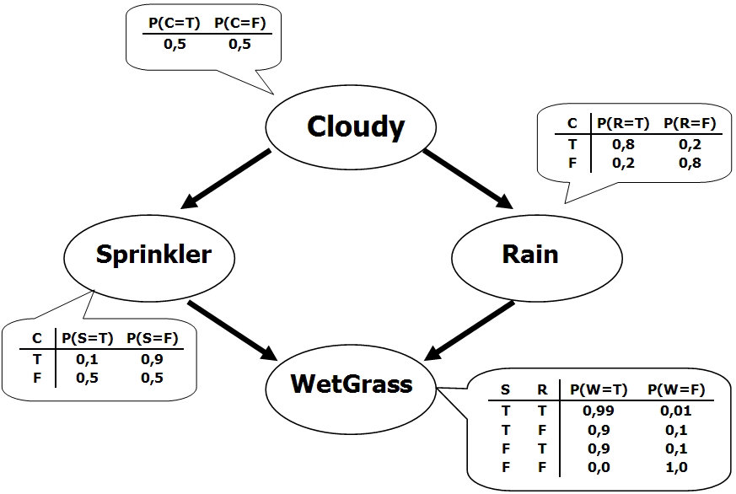
Classical example

Slide 32
One example encoded in 3 PPL
Infer.Net
Figaro
Probabilistic C#

Slide 33
Sources/Citations
Dr. Noah Goodman*, Assistant Professor Linguistics and Computer Science, Stanford university
Dr. Frank Wood*, Associate Professor, Dept. of Engineering Science, University of Oxford
A Revealing Introduction to Hidden Markov Models, Mark Stamp

Slide 34
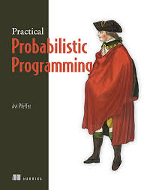
Links
http://probabilistic-programming.org
http://v1.probmods.org
https://www.cra.com/work/case-studies/figaro
http://infernet.azurewebsites.net
https://github.com/joashc/csharp-probability-monad

